Slide 1
Mozi Speech to Text
Nathan Gonzales, Bryant Garcia, Simon Mai, Kalvin Mateo

Slide 2
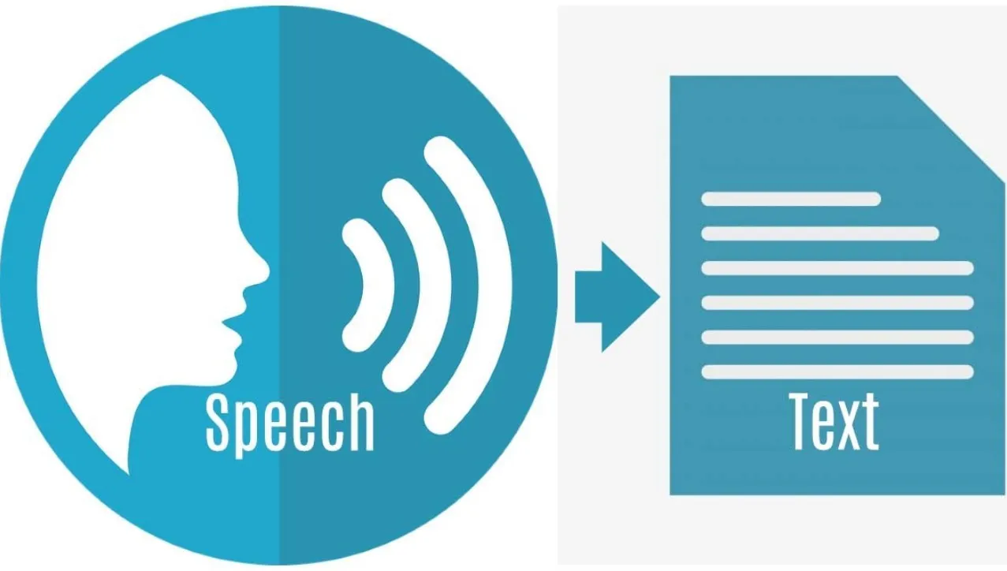
What is Mozi?
Mozi is a speech to text mozilla extension made to benefit user experience. Users will be able to launch the extension and have their voice linked to a search engine server. The result give the User anything they desire to search on the internet. Users targeted for this benefit are the elderly, and those with disabilities that make it difficult to type on a keyboard.

Slide 3
Phase Build
Skeleton of a speech to text recorder was made as a basis for final design.
Alterations and implementation of several unique versions of the extension.
Voice recorder is capable of taking speech to written text and save the text.
The final step needed is to pass recorded text into a search engine.

Slide 4
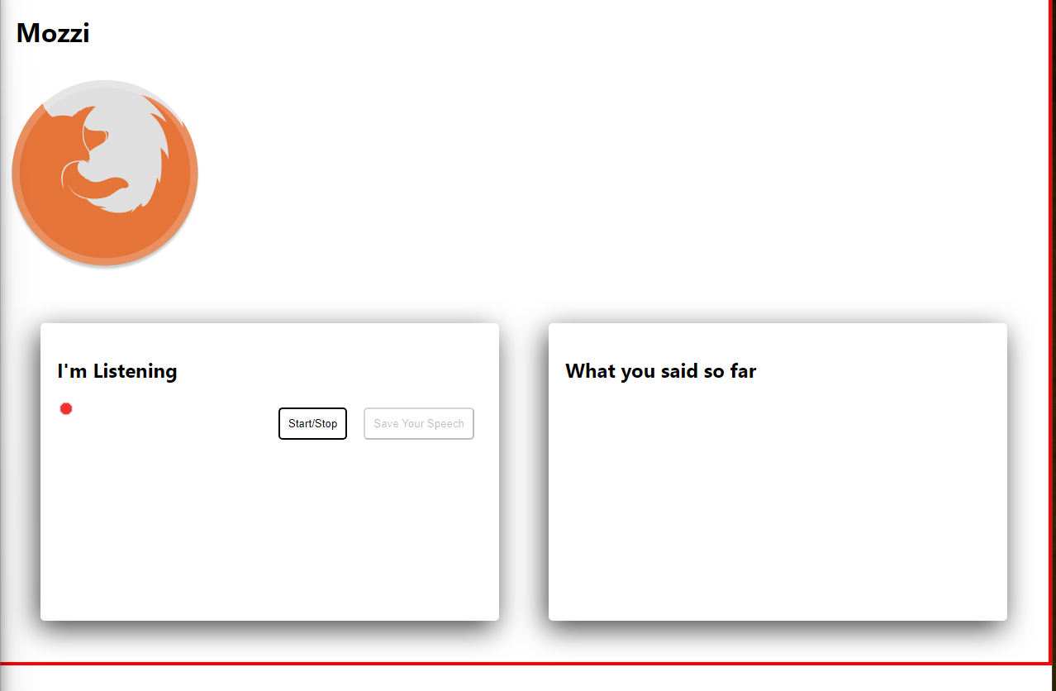
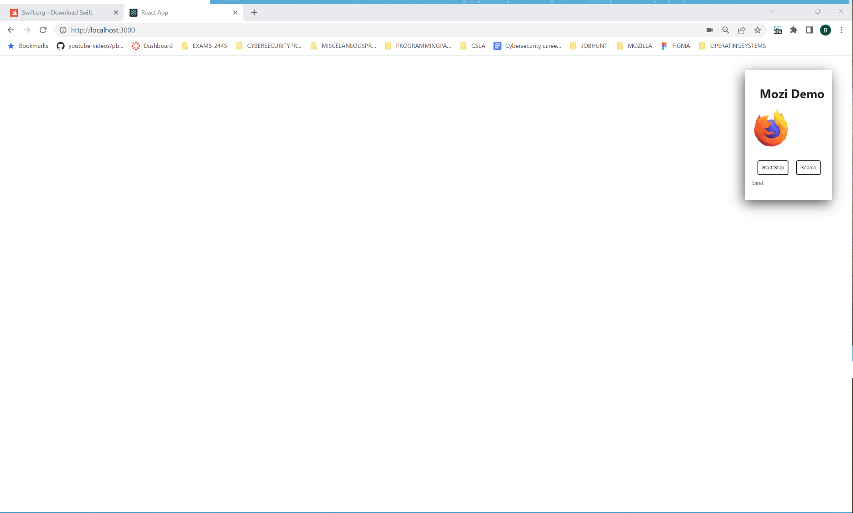
Implementations
Implementation 1
Implementation 2

Slide 5
High Level Design
Extension will activate as user presses a button
A pop out box with an overlay will request microphone access
Recorded audio will be translated to text and saved
Google servers will be contacted and render user text to their search engine
User shall be able to navigate results without losing current data

Slide 6
High Level Design Example

Slide 7
Technical Highlights
Process through the second phase caused the extension to fail which led to mass debugging
Biggest challenges:
Rendering speech to a search engine
Extension is not capable of running on firefox at the moment

Slide 8
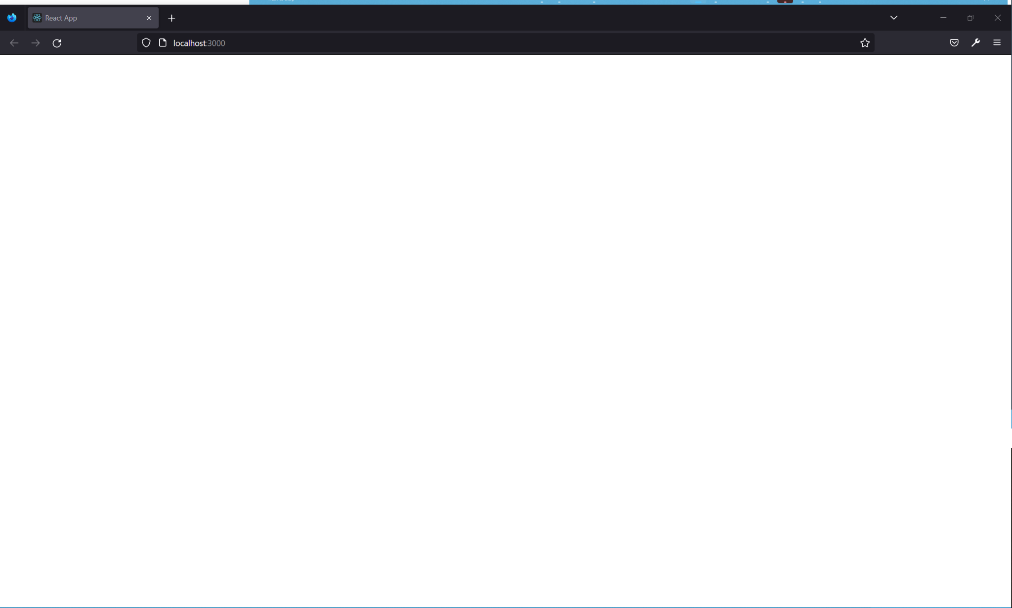
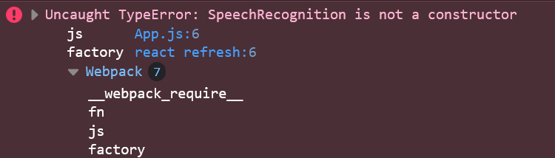
Errors and Debugging
Rendering error
Potential fix for rendering our extension on the mozilla web browser:
Zipping the folder that contains our manifest.json, and not zipping the contents of the folder containing our manifest.json when we run our extension.
For the Speech Recognition error, it was just a matter of checking our syntax and in the end catching something we missed on a div statement.
Speech Recognition error

Slide 9

Final Demo Goals
Fully functioning mozilla extension which will be capable of converting words, phrases, and sentences into text.
Once activated, the extension have a popup window occur and will request microphone access and create the search query
The popup window will then contain the text and search results

